Slide 1
Loops and Nested loops
CSE 100 Competitive Programming
Md. Imran Bin Azad

Slide 2
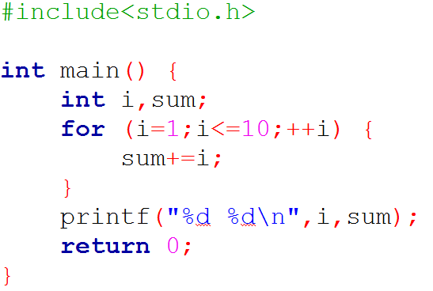
Output?

Slide 3
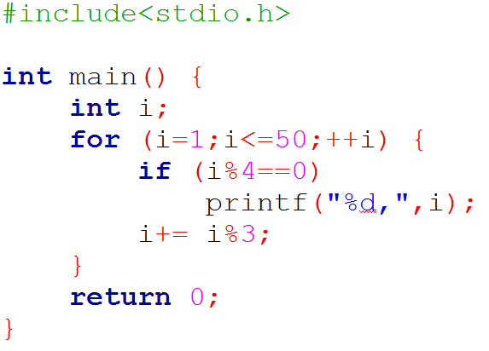
Output?

Slide 4
Food for thought #1
Given an integer number, find the summation of all digits of it.
For example, if the number is 352, your output should be 10 (3+5+2)
Input | Output
352 | 10
1992 | 21

Slide 5
Food for thought #2
Given an integer number:
Part 1: Output it in reverse
Part 2: Store the reverse number in another variable
Input | Output
352 | 235
1992 | 2991

Slide 6
Task #1
Input | Output
3 | 1 3 5 2 4 6 3 5 7
5 | 1 3 5 2 4 6 3 5 7 4 6 8 5 7 9

Slide 7
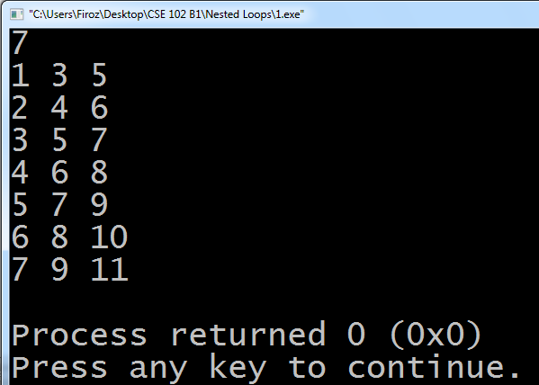
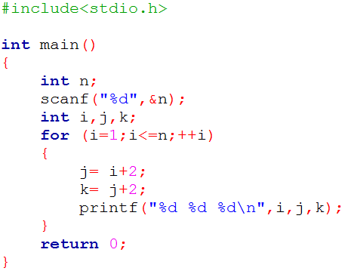

Slide 8
Task #2
Input | Output
3 | 1 2 3 1 2 3 1 2 3
5 | 1 2 3 4 5 1 2 3 4 5 1 2 3 4 5 1 2 3 4 5 1 2 3 4 5

Slide 9
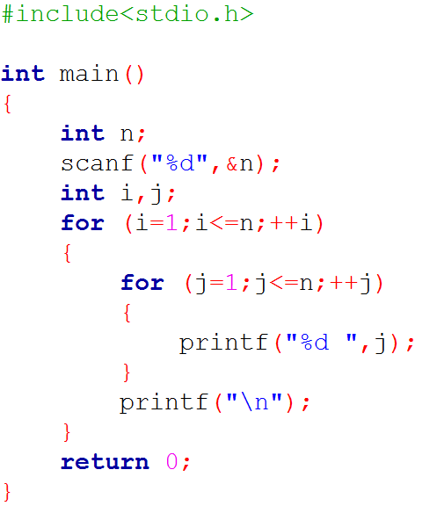

Slide 14
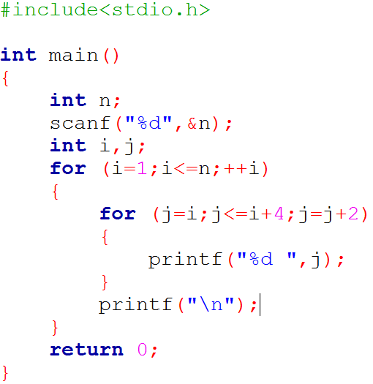
Task #1 (Alternate Solution)

Slide 15
Task | Input | Output
A | 5 | * ** *** **** *****
B | 4 | **** *** ** *
C | 5 | * ** *** **** *****
Task | Input | Output
D | 5 | * * * * * * * * * * * * * * * * * * * * * * * * *
E | 4 | * * * * * * * * * * * * * * * * * * * * * * * * *

Slide 16
Misc.
https://uva.onlinejudge.org/external/107/10783.pdf - OJ Style I/O
Basic operations of a computer
Search
Sort
Others: open, close, edit, delete

Slide 17
Misc.
Arranging an assembly line
Sorting in ascending order
Bubble sort

